Slide 1
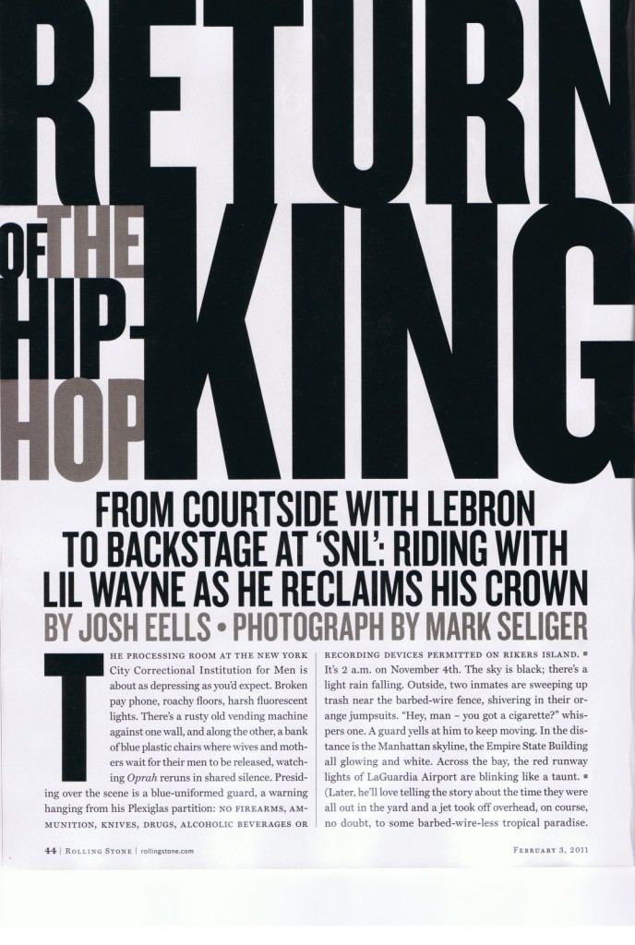
Feature Writing
Features are not a first-hand account of the news. They look at what’s behind the news by exploring the lives of the people behind involved.
Show, don’t tell. Animate your characters and recount events in a way that let the scene do the talking instead of the reporter’s voice.
Avoid repetition. Don’t use a bunch of quotes just because you have quotes. Pick one or two good ones that build the story.
Pay specific attention to your characters. Describe what they look and sound like and where they’re coming from.
Make sure the article moves cleanly from subject to the next.

Slide 2
Research. Research. Research
Do interviews, read articles, find credible info on your subject.
Focus.
Zero in on one aspect. Anorexia is a broad topic. Zero in on how one girl’s improper dieting led to anorexia. Figure out the issue at hand before writing the article.
Read professional features and become familiar with the techniques.
Describe. Describe. Describe.
The best feature writing paints a visual picture. Readers should be able to picture the scene unfolding. Force the reader to use all of their senses when reading the piece. Weave their physical description throughout the piece. Don’t just lump it into one paragraph. Try tying them into a quote. For example: “You should be dead!” he yelled as he pointed with long, raw-boned finger.
5. Use direct quotes. Let the subject tell the story. Keep your opinions out.
6. Dig deep for facts, statistics.
7. Use simile and metaphor for comparison.
8. Write in the third person.
9. There always needs to be a good topic behind your subject and make sure that subject is well-known to readers.
10. If possible, link the ending to the beginning.
11. Rewrite. Rewrite. Rewrite.

Slide 3
Structure of Features: 3 Main Options
Chronological
Take the inverted pyramid and flip it upside down. A good format for stories dealing with a period in time. Could be a class period, a day, a week, a month, a year, or many. They begin with the story itself and work up to the present day or end by looking ahead to the future.
2. Hourglass
Similar to chronological except for the beginning. Starts with the main idea of the story and then flashes back to where the story began chronologically. It then works its way up by order of events.
3. Topical
Some stories can’t be told in chronological order. Topical features work by grouping similar topics together to make the story flow. For example, let’s say you’re doing a story on the common use of Spark Notes by students. You might organize the article like this:
The lead focuses on one student in the school who uses Spark Notes.
The next few paragraphs discuss what Spark Notes are/how they’re used.
The benefits of Spark Notes as seen by the students and teachers.
The drawbacks as seen by students and teachers.
Lastly, a look at alternatives, and final thoughts from the student.

Slide 4
Types of Feature Leads
Descriptive lead - Paint a picture of the scene using every detail
Suspense lead – Has a little mystery to it. Makes reader want to know what happens next.
Striking statement lead – Shock. Want to make the reader say, “Wow, I didn’t know that!”
Summary lead – best for news stories; 5 w’s and H. Can be boring for features.
Question lead – Seldom used because it’s hard to find an earth-shaking question.
Quote lead – Seldom used for same reason as above. Hard to make a reader interested.
Direct address lead – Only effective when the “you” being addressed can identify with the story.
A Few Well-Chosen words lead – This type of lead often pieces sentence fragments together, parallel in structure, and uses at least 3. For example, Dreaded music. Dreaded obstacle. Dreaded Movie. In developing the story, the writer would need to explain what the dreaded music was, what the dreaded obstacle was, and what the dreaded movie was.
Gag lead – something funny.
Delayed or Suspended Interest lead – Withhold vital information to make the reader want to read all the way to the end.

Slide 5
Types of Feature Articles
Human Interest – play the emotions of the reader. Make them laugh, cry, say “WOW!”
Personality Profile – focuses on one aspect of person’s life via an interview.
Sights & Sounds – A different viewpoint on a particular location in the school.
Historical – Focuses on a historical event like the school’s birthday. Don’t over-do.
News – Example: News story on fire. News feature could be aftermath of fire.
Personal Experience – rarely used. Must be a very powerful personal experience.
Informative – heavily researched topic i.e. teen suicide, recycling, bulimia

