Slide 1
What Is News?
What is Copper Hills news?
New info
Previews
Features
Editorials
Who is our audience?
Should we try to impress others?

Slide 2
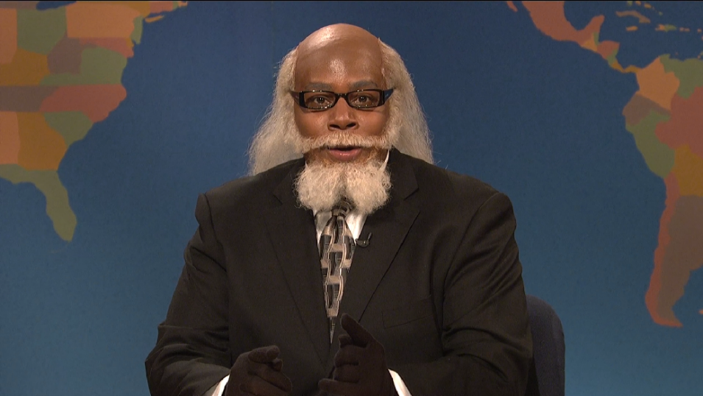
What the !%$# makes something newsworthy these days?
Timeliness
Proximity
Consequence
Prominence
Conflict
Emotions
Unusualness
Human Interest

Slide 3
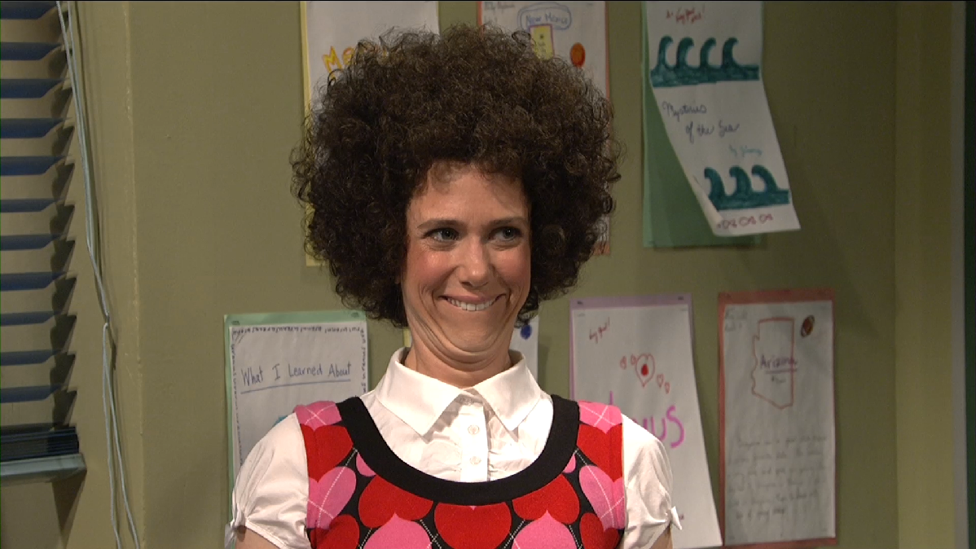
The Essentials of News Writing
Accuracy
Recent Information
Balance
Objectivity
Clear and Concise

Slide 4
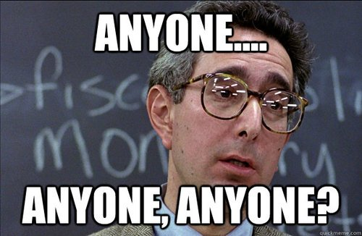
How the $%#@ do we come up with story ideas?
Beats
Alumni
Newspapers
The Professionals
Other Schools
Social Media
School Calendar
Brainstorm

Slide 5
The Reporting Process
Pre-writing
Drafting
Revising
Editing
Publication

Slide 6
Primary
Secondary
Anonymous
Each person in the class write the names of your five closest friends on the board.
Sources

Slide 7
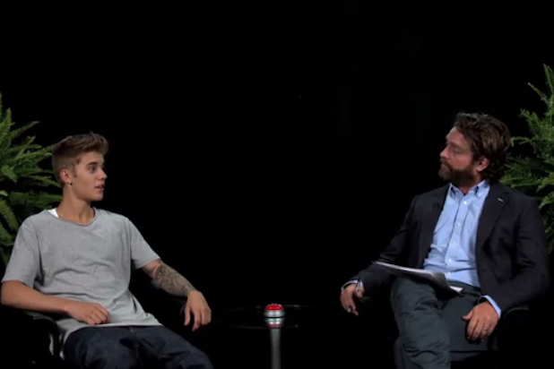
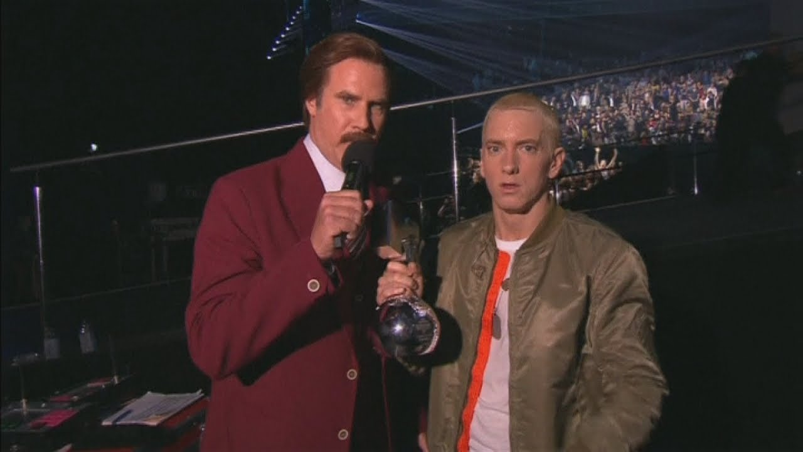
Interviewing
Have up to 20+ questions ready to go ahead of time.
You can begin with a question, but your interview should be commands:
“Tell me about…”
“I’m curious about…”
“Describe your reaction to…”
“I’ve always wondered about…”
“I can’t imagine how that must have felt…” (Pause & Wait)
DO NOT ask yes or no questions, or short answer questions (unless starting with “What is your name, age etc.”
NEVER interrupt your source.
AVOID who, what, when, where, why. “Why did you do it?”
Instead: “Talk to me about your reasons…”

Slide 8
Finding The Best Angle
Before you begin writing, always ask yourself what you’re writing about.
Force yourself to dig deeper for unusual or meaningful quotes.
What can you say in one sentence that tells the whole story?
What images stick out in your mind that you will use to convey the story to the reader?
What statistics should be included?
Consider writing the ending first to help you figure out what direction you want to go.
Look at the story from various points of view. Consider writing the story from a POV other than you had planned.
What facts did you discover, that were the most surprising?
What facts absolutely have to be included? What can you leave out?
Did you learn anything you didn’t expect to?
Try writing your first draft without using notes, then go back and use your notes to build accuracy.
Tell someone else your story, then write it as you told it.

Slide 9
What’s the most important part of the story?
The Lead
5 w’s & H in a paragraph or topic sentence.
Choose words carefully to avoid fluff.
Keep sentences under 30 syllables when possible.
Must make an impact. Hook ‘em.
Typically begin with the who or what.
When and where are typically towards the end.

